Slide 1

Lecture
on
“Advanced Computer Architecture –TCS 704”
by
Akansha Gupta
DEPARTMENT OF COMPUTER SCIENCE AND ENGINEERING
GRAPHIC ERA DEEMED TO BE UNIVERSITY – 248002

Slide 2
PRACTICE PROBLEMS BASED ON DIRECT MAPPING-
Problem-01:
Consider a direct mapped cache of size 16 KB with block size 256 bytes. The size of main memory is 128 KB. Find-
Number of bits in tag
Tag directory size

Slide 3
Solution-
Given-
Cache memory size = 16 KB
Block size = Frame size = Line size = 256 bytes
Main memory size = 128 KB
We consider that the memory is byte addressable.

Slide 4
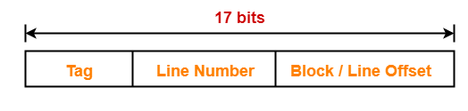
Number of Bits in Physical Address-
We have,
Size of main memory
= 128 KB
= 2¹⁷ bytes
Thus, Number of bits in physical address = 17 bits

Slide 5
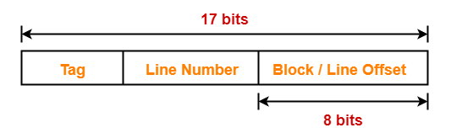
Number of Bits in Block Offset-
We have,
Block size
= 256 bytes
= 2⁸ bytes
Thus, Number of bits in block offset = 8 bits

Slide 6
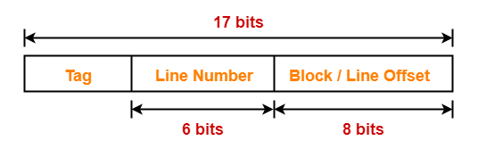
Number of Bits in Line Number-
Total number of lines in cache
= Cache size / Line size
= 16 KB / 256 bytes
= 2¹⁴ bytes / 2⁸ bytes
= 2⁶ lines
Thus, Number of bits in line number = 6 bits

Slide 7
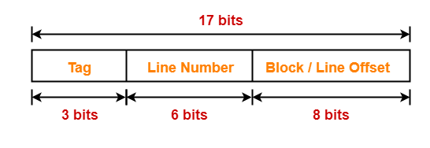
Number of Bits in Tag-
Number of bits in tag
= Number of bits in physical address – (Number of bits in line number + Number of bits in block offset)
= 17 bits – (6 bits + 8 bits)
= 17 bits – 14 bits
= 3 bits
Thus, Number of bits in tag = 3 bits

Slide 8
Tag Directory Size-
Tag directory size
= Number of tags x Tag size
= Number of lines in cache x Number of bits in tag
=2⁶ x 3 bits
= 192 bits
= 24 bytes
Thus, size of tag directory = 24 bytes

Slide 9
Problem-02:
Consider a direct mapped cache of size 512 KB with block size 1 KB. There are 7 bits in the tag. Find-
Size of main memory
Tag directory size

Slide 10
Solution-
Given-
Cache memory size = 512 KB
Block size = Frame size = Line size = 1 KB
Number of bits in tag = 7 bits
We consider that the memory is byte addressable.
Number of Bits in Block Offset-
We have,
Block size
= 1 KB
= 2¹⁰ bytes
Thus, Number of bits in block offset = 10 bits

Slide 11
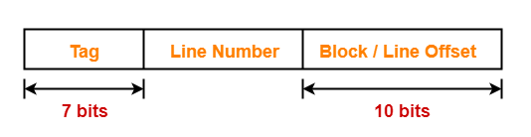
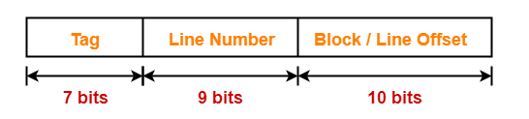
Number of Bits in Line Number-
Total number of lines in cache
= Cache size / Line size
= 512 KB / 1 KB
= 2⁹ lines
Thus, Number of bits in line number = 9 bits

Slide 12
Number of Bits in Physical Address-
Number of bits in physical address
= Number of bits in tag + Number of bits in line number + Number of bits in block offset
= 7 bits + 9 bits + 10 bits
= 26 bits
Thus, Number of bits in physical address = 26 bits
Size of Main Memory-
We have,
Number of bits in physical address = 26 bits
Thus, Size of main memory
= 2²⁶ bytes
= 64 MB

Slide 13
Tag Directory Size-
Tag directory size
= Number of tags x Tag size
= Number of lines in cache x Number of bits in tag
= 2⁹ x 7 bits
= 3584 bits
= 448 bytes
Thus, size of tag directory = 448 bytes

Slide 14
Problem-03:
An 8 KB direct-mapped write back cache is organized as multiple blocks, each of size 32 bytes. The processor generates 32 bit addresses. The cache controller maintains the tag information for each cache block comprising of the following-
1 valid bit
1 modified bit
As many bits as the minimum needed to identify the memory block mapped in the cache
What is the total size of memory needed at the cache controller to store meta data (tags) for the cache?
4864 bits
6144 bits
6656 bits
5376 bits

Slide 15
Solution-
Given-
Cache memory size = 8 KB
Block size = Frame size = Line size = 32 bytes
Number of bits in physical address = 32 bits
Number of Bits in Block Offset-
We have,
Block size
= 32 bytes
= 2⁵ bytes
Thus, Number of bits in block offset = 5 bits

Slide 16
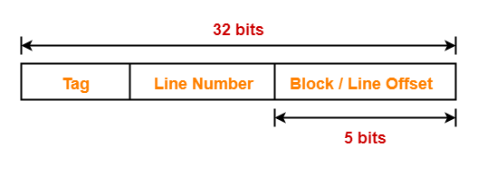
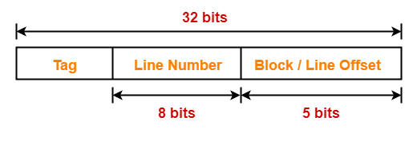
Number of Bits in Line Number-
Total number of lines in cache
= Cache memory size / Line size
= 8 KB / 32 bytes
= 2¹³ bytes / 2⁵ bytes
= 2⁸ lines
Thus, Number of bits in line number = 8 bits

Slide 17
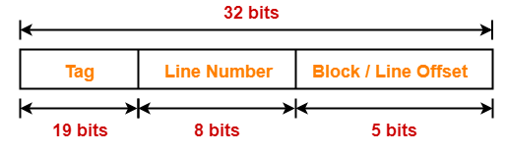
Number Of Bits in Tag-
Number of bits in tag
= Number of bits in physical address – (Number of bits in line number + Number of bits in block offset)
=32 bits – (8 bits + 5 bits)
= 32 bits – 13 bits
= 19 bits
Thus, Number of bits in tag = 19 bits

Slide 18
Memory Size Needed At Cache Controller-
Size of memory needed at cache controller
= Number of lines in cache x (1 valid bit + 1 modified bit + 19 bits to identify block)
= 2⁸ x 21 bits
= 5376 bits

Slide 19
https://youtu.be/sK7f4EzNhNY
THANKS

